Slide 1

Linear Regression

Slide 2

TABLE OF CONTENTS
01
02
03
Regression problem
The mechanism behind
Alternative regressions

Slide 3

01
Regression problem

Slide 4

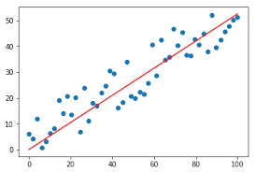
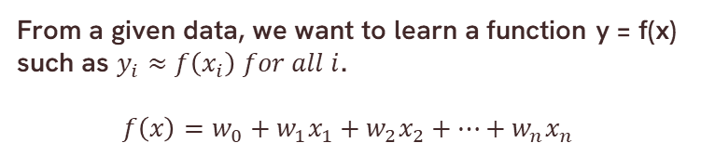
Why do we need it?
From a given data, we want to learn a function y = f(x) such as $y_{i}≈f\left(x_{i}\right) for all i$.
$$f\left(x\right)=w_{0}+w_{1}x_{1}+w_{2}x_{2}+…+w_{n}x_{n}$$

Slide 5
Learning goal
Learn a function f* such that its prediction in the future is the best
=> Its generalization is the best

Slide 6

The mechanism behind
02

Slide 7

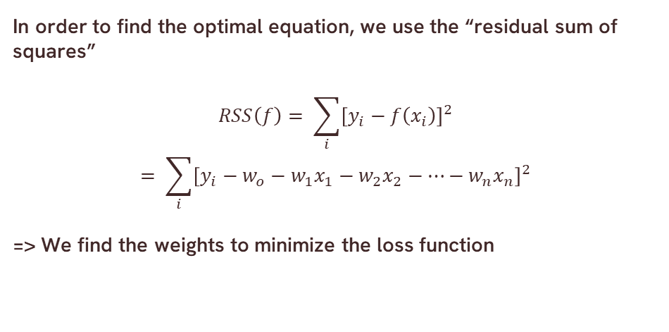
Loss function
In order to find the optimal equation, we use the “residual sum of squares”
$$RSS\left(f\right)= \sum_{i}{{\left[y_{i}−f\left(x_{i}\right)\right]}^{2}}$$
$$= \sum_{i}{{\left[y_{i}−w_{o}−w_{1}x_{1}−w_{2}x_{2}−…−w_{n}x_{n}\right]}^{2}}$$
=> We find the weights to minimize the loss function

Slide 8
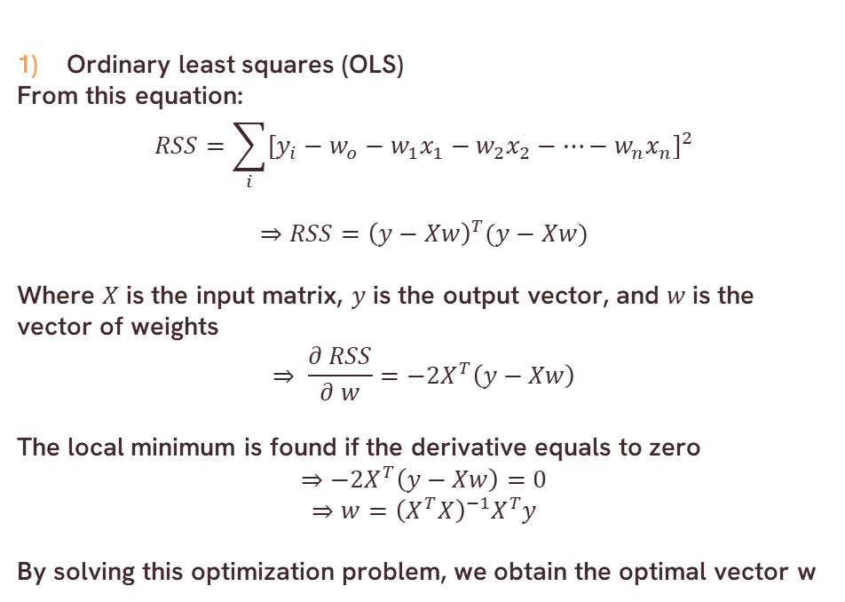
Finding weights method
Ordinary least squares (OLS)
From this equation:
$$⇒RSS={\left(y−Xw\right)}^{T}(y−Xw)$$
Where $X$ is the input matrix, $y$ is the output vector, and $w$ is the vector of weights
$$⇒ \frac{∂ RSS}{∂ w}=−2X^{T}\left(y−Xw\right)$$
The local minimum is found if the derivative equals to zero
$$⇒−2X^{T}\left(y−Xw\right)=0$$
$$⇒w={\left(X^{T}X\right)}^{−1}X^{T}y$$
By solving this optimization problem, we obtain the optimal vector w

Slide 9
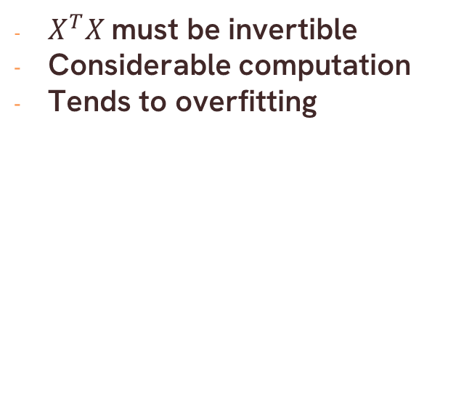
Problem
$X^{T}X$must be invertible
Considerable computation
Tends to overfitting

Slide 10
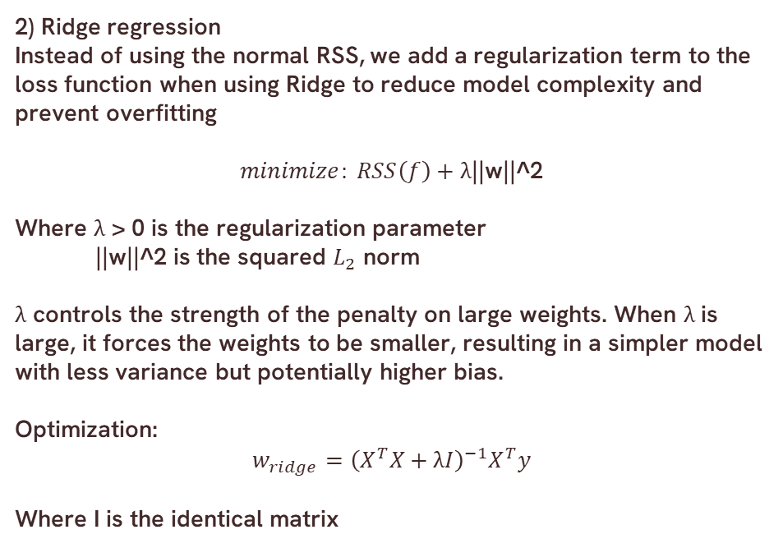
Finding weights method
2) Ridge regression
Instead of using the normal RSS, we add a regularization term to the loss function when using Ridge to reduce model complexity and prevent overfitting
$$minimize: RSS\left(f\right)+\text{λ}\text{||}\text{w}\text{||^}\text{2}$$
Where λ > 0 is the regularization parameter
$\text{||}\text{w}\text{||^}\text{2}$ is the squared $L_{2}$ norm
λ controls the strength of the penalty on large weights. When λ is large, it forces the weights to be smaller, resulting in a simpler model with less variance but potentially higher bias.
Optimization:
$$w_{ridge}={\left(X^{T}X+\text{λ}I\right)}^{−1}X^{T}y$$
Where I is the identical matrix

Slide 11
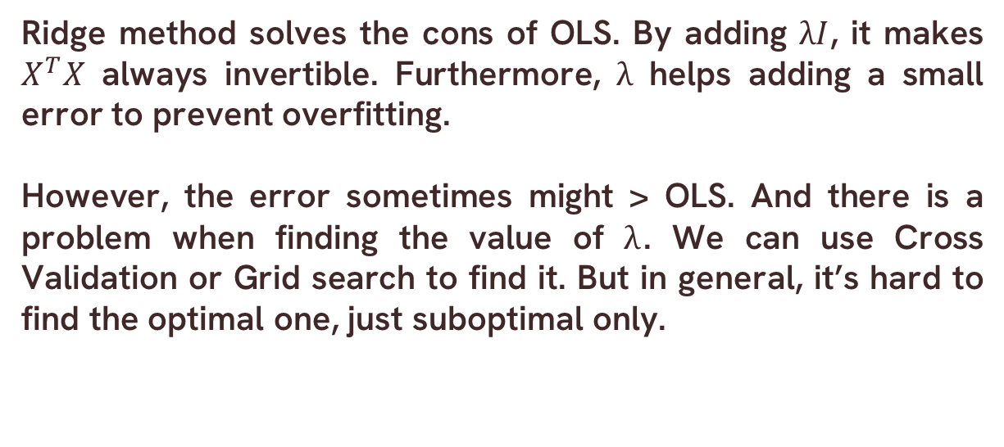
Ridge method solves the cons of OLS. By adding $\text{λ}I$, it makes $X^{T}X$ always invertible. Furthermore, $\text{λ}$ helps adding a small error to prevent overfitting.
However, the error sometimes might > OLS. And there is a problem when finding the value of $\text{λ}$. We can use Cross Validation or Grid search to find it. But in general, it’s hard to find the optimal one, just suboptimal only.

Slide 12
The end

